Slide 1




Degree Debate
Allison R. Deming (IST 618)

Slide 2
Why a Master’s Degree?
1. The Department of Labor says that Master’s Degrees earn you 20% more across your life..
2. Is 20% enough for the student debt you incur?
This very much depends on the financial literacy you have, the type of school you choose to attend (public, private) if you choose to work during graduate school to help offset the costs, qualify for Pell Grants, Apply for Scholarships, Take Assistantships, Qualify for Loan Forgiveness (PSLF) and so forth.

Slide 3

Reputation

Slide 4

Like it or not….
Where you complete your Degree has either a conscious or subconscious influence on the person hiring you, for good or bad.
Many lower-cost, less established programs do not carry the same accreditation as those required by many jobs (regional and national). These are usually only found with an established University, College, or similar system.
Degrees may get you in the door to places you would otherwise not have a chance at, and the ability to network through your college is another way to get a job placement.
Even programs within colleges have reputations…..A few poorly trained people in a professional field can blacklist graduates from being hired. So again, where you go matters.

Slide 5
Education Pays in Other Ways…..
Those with a graduate or college degree are more likely to have a retirement program, insurance, and other forms of additional compensation (stock options, etc.).
The longer you stay in school, the longer you live (likely due to health insurance benefits).
According to the US Census Bureau, 1% of higher education graduates participated in social support programs like Medicaid or National School Lunch Program.
Notes:
Sandy Baum, Jennifer Ma, and Kathleen Pays, "Education Pays 2010: The Benefits of Higher Education for Individuals and Society," collegeboard.com, 2010

Slide 6

Interpersonal/Soft Skills Jobs Want
Students can interact with other students and faculty, join student organizations and clubs, and participate in discussions and debates (like this one).
Learning to work with people unlike you.
Raise your hand if you have ever had a difficult team member?
Arthur Chickering, "The Seven Vectors: An Overview," cabrini.edu (accessed Sep. 5, 2013)

Slide 7

Build Knowledge In A Field You Love
Lifelong learning is something we should all strive to do, but if you plan to work in Academia or teach, a Bachelor’s Degree, Master’s Degree (and if you want to work at a Tier I Research Institution), a Ph.D. is REQUIRED.
Also, an excellent way to CHANGE your career.

Slide 8
Opportunities to Work In Academia
Graduate school allows you to work with researchers who are top in their field and have publishing and teaching experience.
You learn from those who have worked in the field and can let you know what to expect in interviews and what the field is genuinely like (about 50% of Ph.D. students drop out before completion because it is not what they want to do. That is a lot of work for not fully knowing the job).
The opportunity for internships as part of your education to give you work experience while you are still early in your career.
Over 80% of college students complete internships before graduation, giving them valuable employment experience before entering the job market.
Notes:
Indiana University at Bloomington, "Internship Experiences of IUB Psychology Majors – 50+ Examples," indiana.edu (accessed Sep. 26, 2013)

Slide 9
The Surest Bet….
“On the whole, an advanced degree remains the surest bet for social and economic advancement. The economic returns of college are incredibly profound for low-income students, yet they are far more susceptible to college avoidance than their more affluent peers, who are likely to go to college anyway. Such is hugely problematic for those hoping to improve economic mobility in the United States. Almost all the job and wage growth now goes to people with some form of postsecondary education.” (Emphasis Added)
Notes:
“The Dangerous Message in Telling Low-Income Students to Skip College,” available at hechingerreport.org 2019

Slide 10
Access To University Resources
Student Success Counselors
University Tutoring Services
University Health Services
Adjunct Professors (Professional Experience)
Full Time Professors (Academics)
Career Resources

Slide 11
Better For The Economy
“[M]ost students who finish a U.S. higher education have trained minds that can handle a variety of positions and occupations. While that may not materialize for every student, it’s simply folly to argue that we should discourage higher ed aspirations for millions because there are unfilled jobs in service fields. Meanwhile, China knows that higher ed attainment is directly correlated to thriving economies. That’s why they export their students here and import our universities’ practices…
Our society loses the ability to function when its citizens do not know history, cannot and are not trained to read complicated texts, and cannot weigh decisions for themselves, their world…
Any employer wants employees who can problem-solve and know how to learn. There are many paths to those attributes, but college – or some modern evolution— is the most likely equalizer for these soft skills.”
Notes:
Jeanne Allen, MS, founder of the Center for Education Reform, wrote in a Mar. 28, 2019 article titled “College Isn’t For Whom?,” available at forbes.com:

Slide 12
A Quote From My Dad…..
He was a hospital administrator for 45 years and has recently retired and did a lot of hiring and firing.
“I remember hiring one guy for the administrative offices with a Certificate from the University of Wisconsin. They have extensive online programs and a good reputation in the field. He worked out well, but the newer things I see commercials for concern me as there are so many, and it is hard to know what you are truly getting from an employer standpoint. Where I can see utility is within your job, the lesser-known aspects to you as an employee – that could be considered continuing education. Additionally, no one knows the entire job as well as their core skill set.”.
Notes:
Source: Carl Hollingsworth (208-450-9353)

Slide 13
The End: Questions?

Slide 14
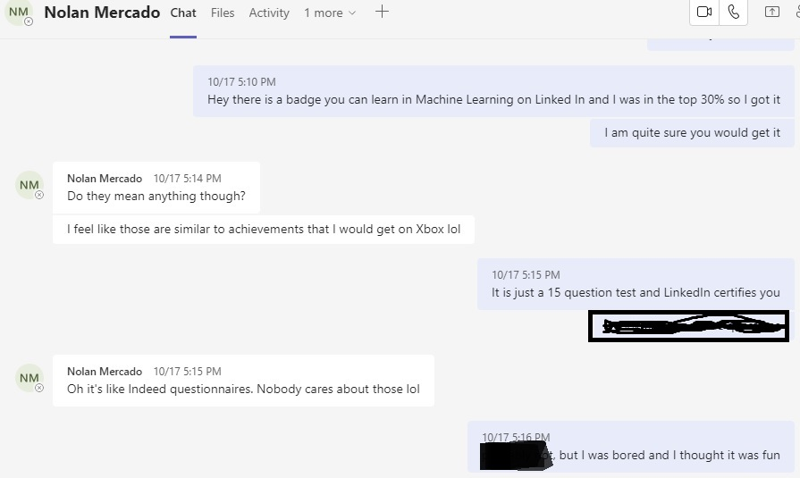

Slide 15
